Slide 1
Training Models (Regression) By- Dr. Amit Rathi, Dept of CSE, JUET, Guna

Slide 2
Regression
Regression is a statistical and machine learning method used to model the relationship between a dependent variable (target) and one or more independent variables (predictors) to predict continuous numerical outcomes.

Slide 3
Regression
Regression in machine learning is a supervised learning technique that predicts continuous numerical outcomes (like prices or temperatures) by modeling the relationship between input features (independent variables) and a target variable (dependent variable),
Finding a best-fit line or curve to map inputs to outputs for forecasting, risk analysis, and trend detection.

Slide 4
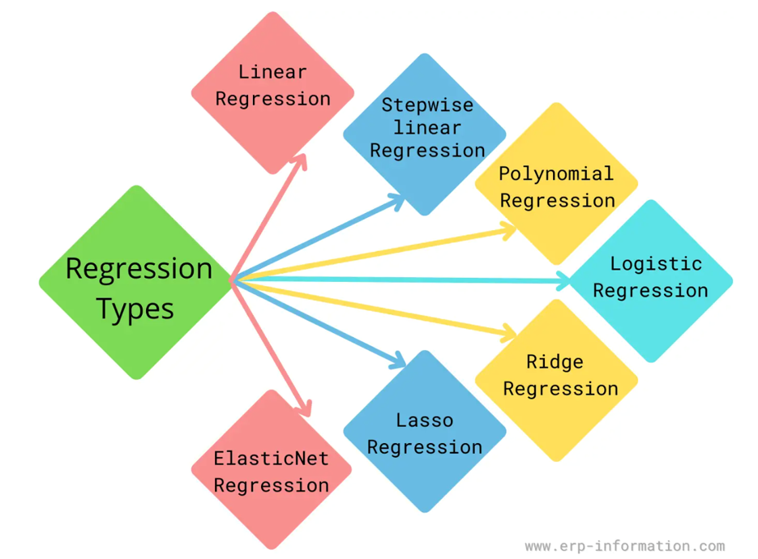

Slide 5
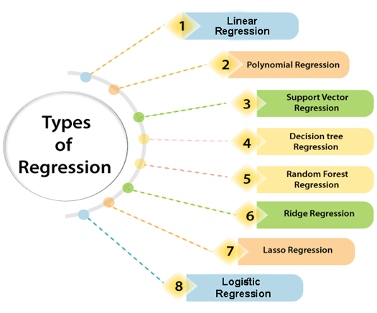

Slide 6
Regression
It differs from classification, which predicts discrete categories, focusing instead on real-valued predictions.
Types of regression:
- Linear Regression,
- Polynomial Regression, and
- Logistic Regression

Slide 7
Linear Regression
Linear regression is a supervised machine learning algorithm that models the relationship between a dependent variable and one or more independent variables by fitting a linear equation to observed data.
In linear regression, the best-fit line is the straight line that most accurately represents the relationship between the independent variable (input) and the dependent variable (output).

Slide 8
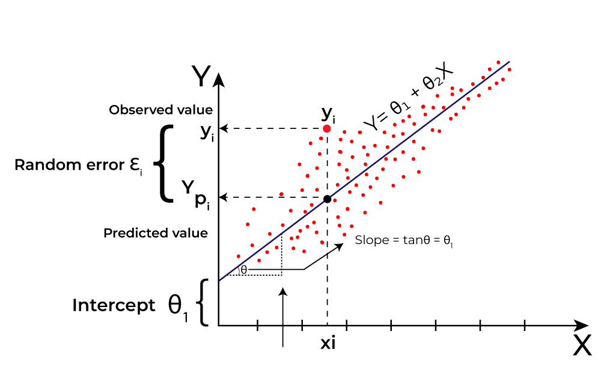
Linear Regression
Y is called a dependent or target variable and X is called an independent variable also known as the predictor of Y.
θ1​ represents the intercept, which is the value of Y when X = 0
θ2​ represents the slope, which shows how much Y changes for a unit change in X

Slide 9
Linear Regression
The goal of linear regression is to find a straight line that minimizes the error (the difference) between the observed data points and the predicted values.
This line helps us predict the dependent variable for new, unseen data.

Slide 10
Linear Regression
For simple linear regression (with one independent variable), the best-fit line is represented by the equation
y = mx + b Sum of squared errors (SSE)
y=mx+b
Where:
y is the predicted value (dependent variable)
x is the input (independent variable)
m is the slope of the line (how much y changes
when x changes)
b is the intercept (the value of y when x = 0)

Slide 11
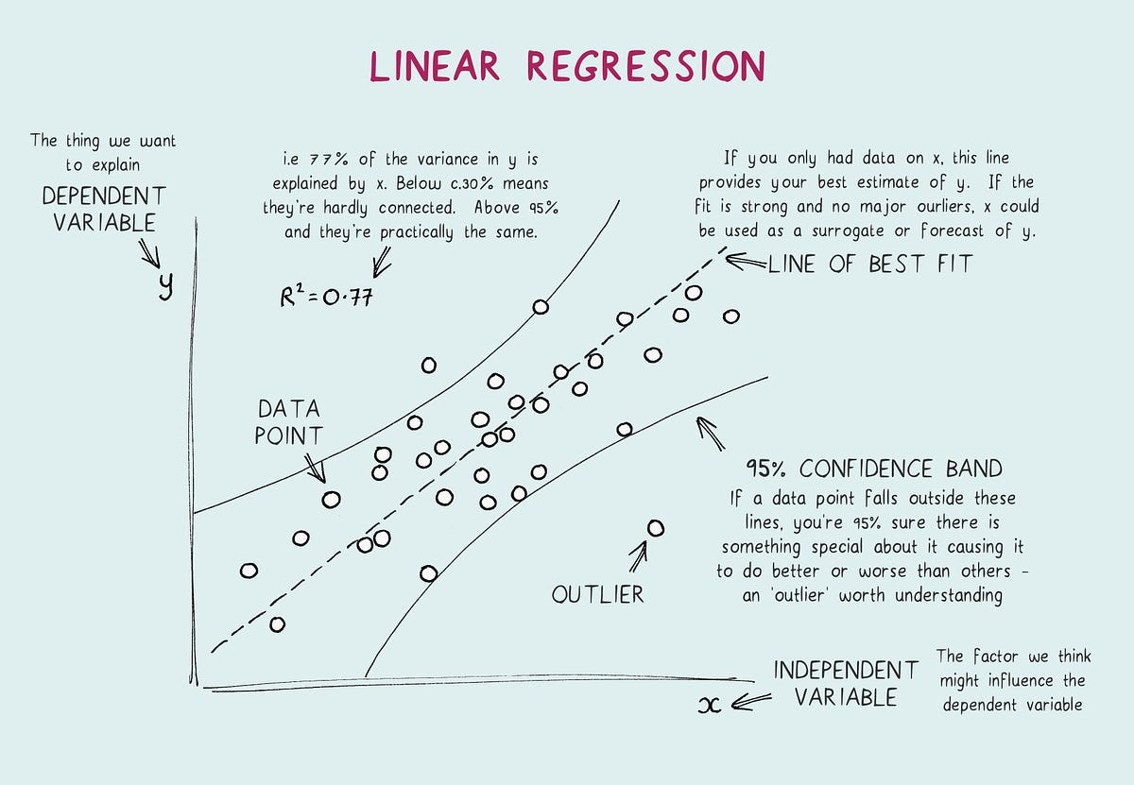

Slide 12
Multiple Linear Regression
Multiple Linear Regression:
Extends simple linear regression to include multiple independent variables:
Y = β0 + β1X1 + β2X2 +….…+ βpXp + ϵ
where
X1,X2,…,Xpare the independent variables,
β0,β1,…,βp​ are the coefficients, and
ϵ is the error term.

Slide 13
Ridge and Lasso Regression
Ridge and Lasso Regression:
Techniques used to handle multicollinearity (high correlation among independent variables) and prevent overfitting by adding regularization terms to the regression equation.
LASSO Regression - Least Absolute Shrinkage and Selection Operator Regression

Slide 14
Polynomial Regression
Polynomial regression is a type of regression analysis that models the non-linear relationship between independent (x) and dependent (y) variables by fitting a curved line using an n-th degree polynomial equation -
It extends linear regression to capture more complex, fluctuating data patterns while remaining linear in the parameters, allowing for estimation using traditional least squares methods.

Slide 15
Polynomial Regression
y is the dependent variable.
x is the independent variable.
m0, m1,m2…..mn are the coefficients of the polynomial terms.
n is the degree of the polynomial
c represents the error term

Slide 16
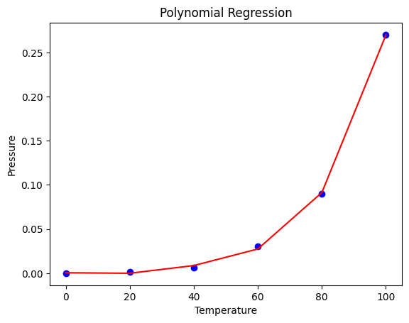
Polynomial Regression

Slide 17
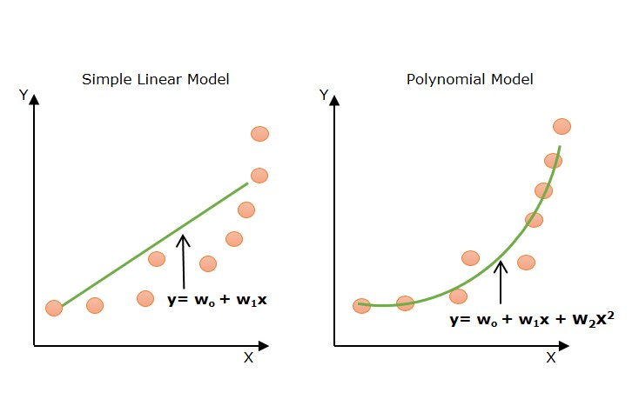

Slide 18
Logistic Regression
Logistic Regression is a fundamental supervised machine learning algorithm used primarily for binary classification (predicting one of two outcomes, 0 or 1) by calculating the probability of an event occurring.
It uses the sigmoid function to map linear predictions to a 0-1 probability range, making it ideal for tasks like spam detection, disease diagnosis, or loan approval.

Slide 19
Logistic Regression
Logistic Regression is used when the dependent variable is categorical. It models the probability of a certain category or outcome (binary or multinomial) based on predictor variables.
Logistic Regression is a statistical method used for binary classification problems, where the goal is to predict the probability that a given input belongs to one of two classes (usually labeled 0 and 1). It's widely used in various fields like finance, healthcare, marketing, etc., to predict outcomes like whether a customer will churn, whether an email is spam, or whether a patient has a disease.

Slide 20
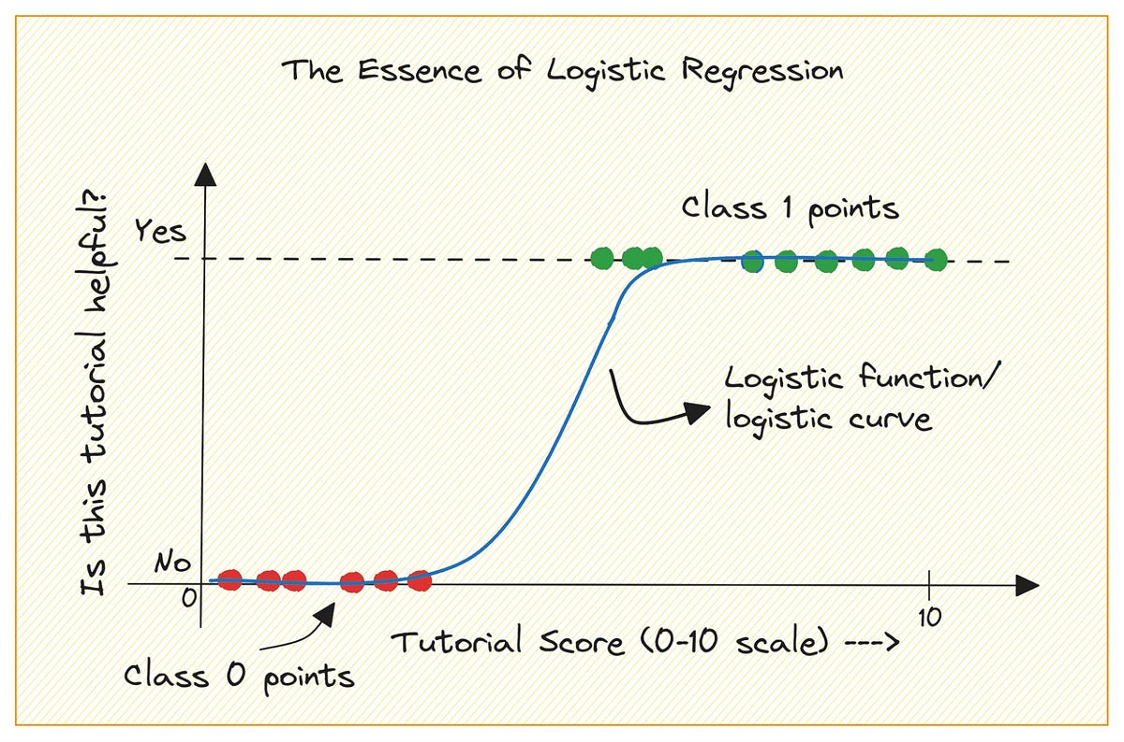
Logistic Regression

Slide 21
Logistic Regression
Key Aspects of Logistic Regression
Purpose: Predicts categorical, discrete outcomes (Yes/No, True/False).
The Sigmoid Function: Unlike linear regression, it uses an S-shaped (sigmoid) curve to map input variables to a value between 0 and 1, representing probability.

Slide 22
Logistic Regression
Binary & Multinomial: While often used for binary classification, it can be extended to multi-class scenarios (Multinomial Logistic Regression) or ranked categories (Ordinal Logistic Regression).
Interpretation: It models the relationship between independent variables and the log-odds of the dependent variable, revealing how different predictors affect outcomes.
Loss Function: It typically uses cross-entropy loss to minimize the difference between predicted probabilities and actual outcomes.

Slide 23
Logistic Regression
Key Concepts of Logistic Regression
1. Binary Classification: Logistic Regression is typically used when the dependent variable (target) is categorical with two classes, like:
Class 1 (positive class) – 1
Class 0 (negative class) – 0

Slide 24
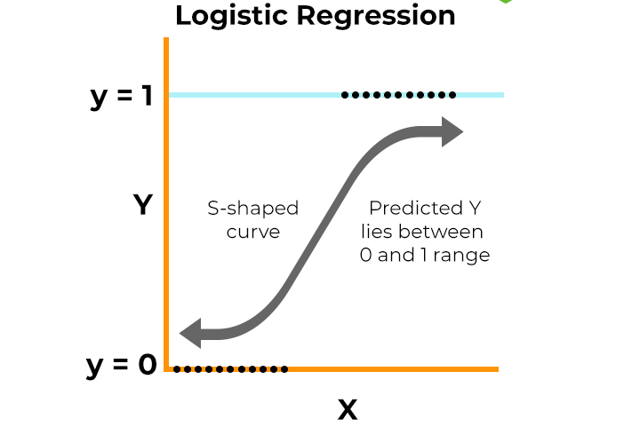

Slide 25
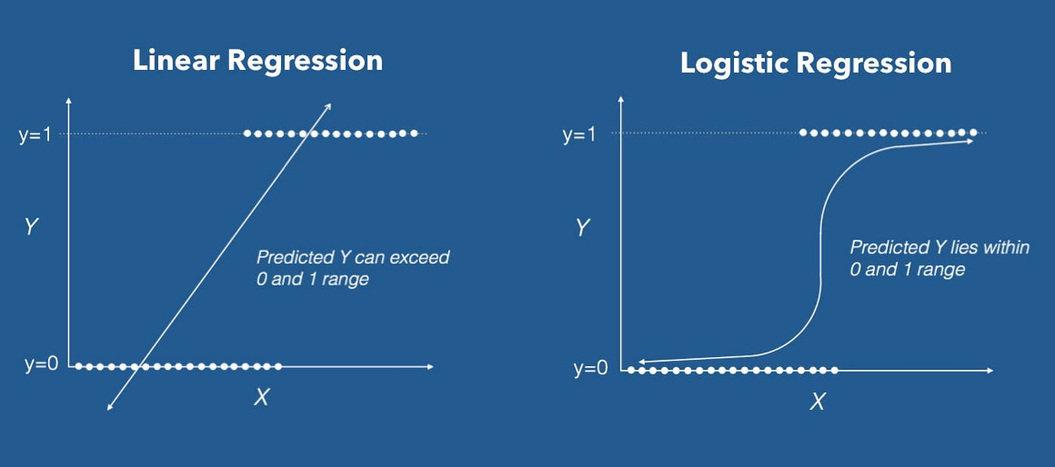

Slide 26
Logistic Regression
3. Prediction and Decision Boundary:
The output of the sigmoid function is a probability value between 0 and 1, representing the likelihood that an input belongs to class 1.
Typically, a threshold of 0.5 is used: If the probability is greater than or equal to 0.5, the instance is classified as class 1; otherwise, it’s classified as class 0.
4. Objective: The goal of logistic regression is to find the best-fit line (or decision boundary) that separates the classes in the feature space. This is done by maximizing the likelihood function or equivalently minimizing the log-loss function.

Slide 27
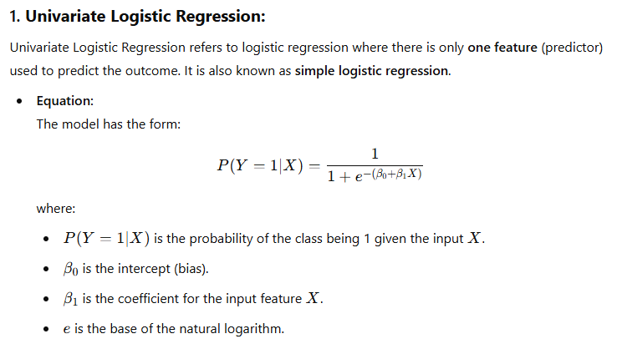
Logistic Regression

Slide 28
Logistic Regression
Example use case: Predicting if a person will buy a product based on the number of times they have visited the website.
Interpretation: The output is a probability between 0 and 1. Based on a threshold (e.g., 0.5), we classify the result into one of two classes (0 or 1). If the probability is greater than the threshold, the prediction is class 1; otherwise, it's class 0.

Slide 29
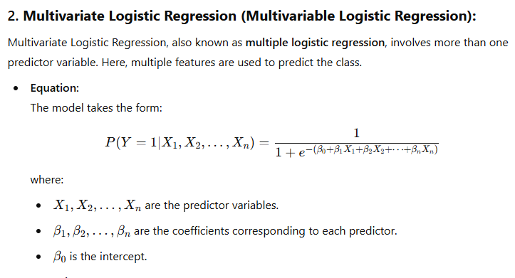
Logistic Regression

Slide 30
Logistic Regression
Example use case: Predicting whether a patient has a certain disease based on age, weight, blood pressure, cholesterol level, and other medical factors.
Interpretation: Just like univariate logistic regression, the output is a probability, but here it’s influenced by multiple predictors. The coefficients β1,β2,…… tell us how strongly each feature contributes to the prediction.

Slide 31
Logistic Regression
Key Differences:
Number of Features:
Univariate uses one feature to predict the outcome.
Multivariate uses multiple features to predict the outcome.
Model Complexity:
Univariate is simpler and easier to interpret.
Multivariate is more complex but allows for more nuanced decision boundaries.
Applicability:
Univariate is limited to simple cases where one feature is a strong predictor of the outcome.
Multivariate is more flexible and applicable to real-world problems where multiple factors influence the outcome.

Slide 32
Logistic Regression
Steps to Implement Logistic Regression
Prepare Data:
Clean the data, handle missing values, and encode categorical variables if needed.
Scale or normalize the features if the dataset contains features with very different ranges (optional but often useful).
Train the Model:
Fit the logistic regression model to the training data by adjusting the parameters β0,β1,…​. This is done by minimizing the cost function (often the log loss function).
Model Evaluation:
Use various metrics like accuracy, precision, recall, F1-score, and ROC-AUC to evaluate the performance of the model on test data.
Make Predictions:
Once trained, use the model to predict the class of new, unseen data by computing the probability using the sigmoid function and applying the threshold (usually 0.5).

Slide 33
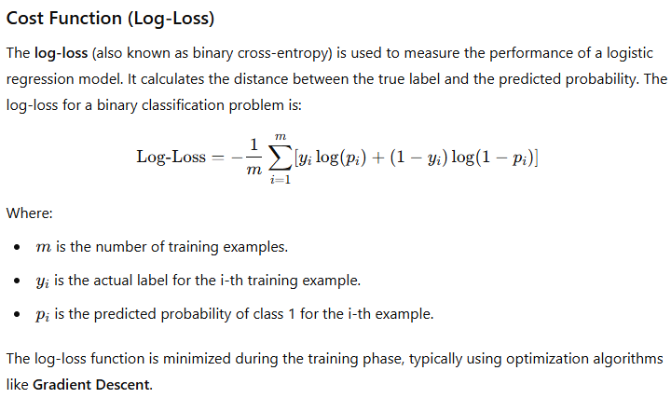
Logistic Regression

Slide 34
Logistic Regression
Regularization in Logistic Regression
Sometimes, regularization is applied to logistic regression to prevent overfitting, especially when there are many features. Regularization techniques include:
L1 regularization (Lasso): Adds a penalty proportional to the absolute value of the coefficients.
L2 regularization (Ridge): Adds a penalty proportional to the squared value of the coefficients.

Slide 35
Logistic Regression
Pros and Cons of Logistic Regression
Pros:
Simple to understand and implement.
Efficient for binary classification.
Interpretable model: Coefficients can indicate the relationship between features and the target.
Works well with linearly separable data.
Cons:
Assumes a linear relationship between the input features and the log-odds of the target variable (not always true in real-world problems).
Sensitive to outliers.
May not perform well on complex, non-linear relationships without additional transformations or feature engineering.

Slide 36
Regression Analysis
Steps in Regression Analysis:
Data Collection: Gather data on the variables of interest (dependent and independent variables).
Exploratory Data Analysis (EDA): Understand the relationships between variables through visualizations and summary statistics.
Model Building: Choose the appropriate regression model based on the data and the problem context.

Slide 37
Regression Analysis
Model Evaluation: Assess the goodness of fit using metrics like R² (coefficient of determination), adjusted R², or other relevant metrics.
Interpretation: Interpret the coefficients to understand the relationships between the variables.
Prediction and Inference: Use the model to predict outcomes for new data and draw conclusions based on the analysis.

Slide 38
Regression Analysis
Applications:
Economics: Studying the impact of factors like inflation or unemployment on GDP.
Marketing: Analyzing how advertising spending affects sales.
Health Sciences: Predicting patient outcomes based on medical data.
Social Sciences: Understanding factors influencing voting behavior.
Engineering: Predicting the strength of materials based on experimental data.
Regression analysis is a versatile tool in statistics and data analysis, providing insights into relationships between variables and enabling predictions and decision-making based on data-driven models.

Slide 39
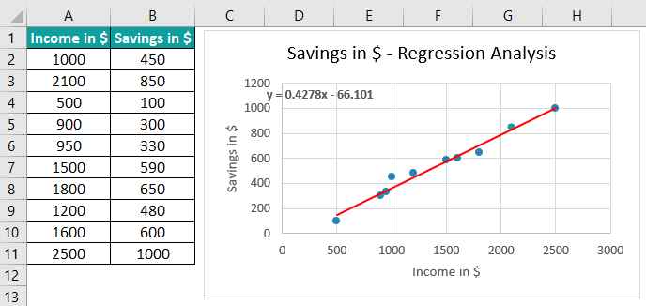

Slide 40
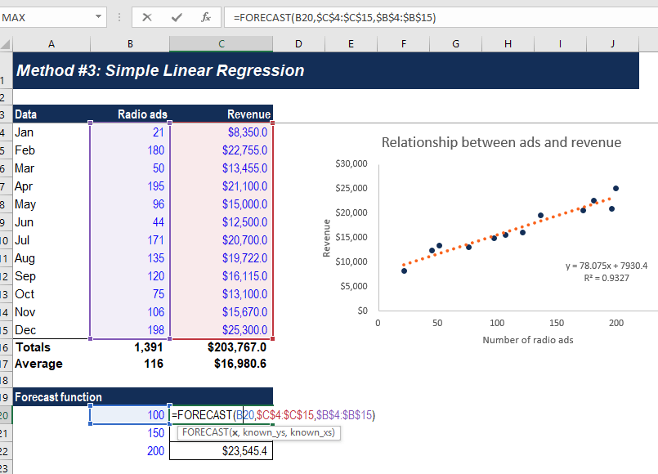

Slide 41
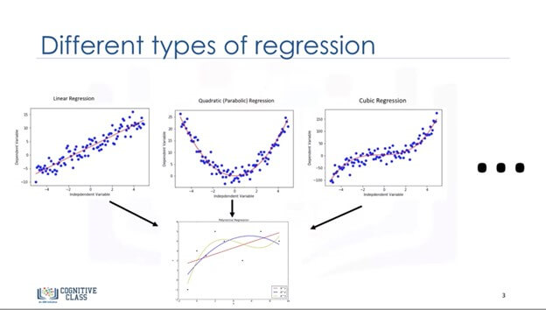

Slide 42
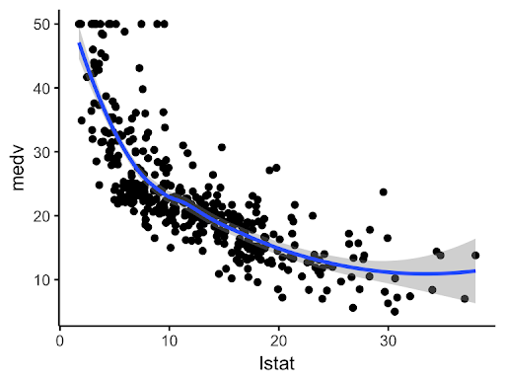

Slide 43
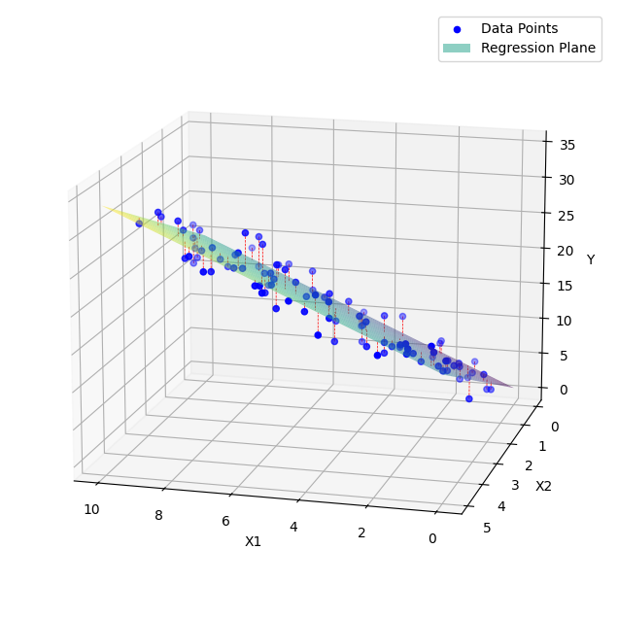

Slide 44
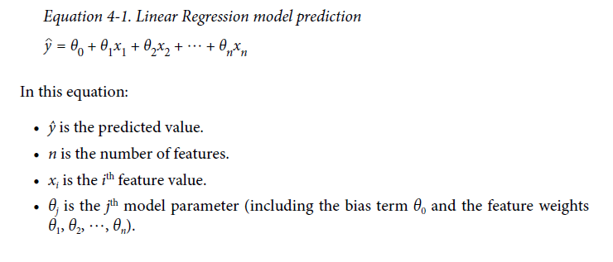
Linear Regression (Aurélien Géron)
A linear model makes a prediction by simply computing a weighted sum of the input features, plus a constant called the bias term (also called the intercept term)

Slide 45
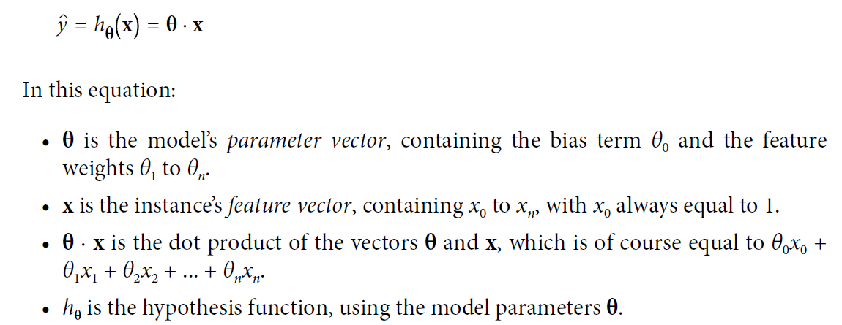
Linear Regression
This (eqn 4.1) can be written much more concisely using a vectorized form, as shown

Slide 46
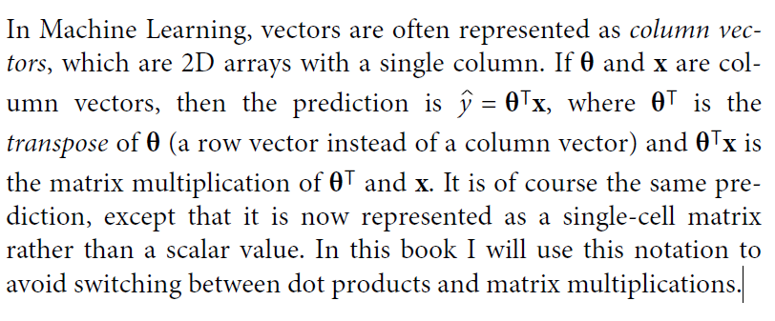
Linear Regression

Slide 47
Linear Regression
How do we train it?
Training a model means setting its parameters so that the model best fits the training set.
For this purpose, we first need a measure of how well (or poorly) the model fits the training data.
The most common performance measure of a regression model is the Root Mean Square Error (RMSE) (Equation 2-1).

Slide 48
Linear Regression
Therefore, to train a Linear Regression model, we need to find the value of θ that minimizes the RMSE.
In practice, it is simpler to minimize the mean squared error (MSE) than the RMSE, and it leads to the same result (because the value that minimizes a function also minimizes its square root).

Slide 49
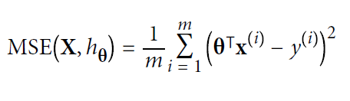
Linear Regression
MSE cost function for a Linear Regression model:-
m is the number of instances in the dataset
x^{(i)} is a vector of all the feature values
h is your system’s prediction function, also called a hypothesis
MSE(X,h) is the cost function measured on the set of examples using your hypothesis h.

Slide 50
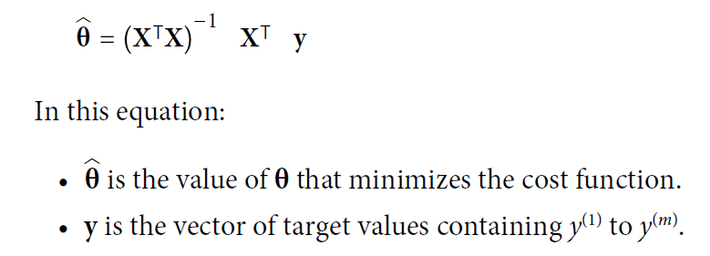
Linear Regression
The Normal Equation:
To find the value of θ that minimizes the cost function, there is a closed-form solution in other words, a mathematical equation that gives the result directly.
This is called the Normal Equation

Slide 51
Linear Regression
Computational Complexity :
The Normal Equation computes the inverse of X⊺ X, which is an (n + 1) × (n + 1) matrix (where n is the number of features).
The computational complexity of inverting such a matrix is typically about O(n^{2.4}) to O(n³), depending on the implementation.
In other words, if you double the number of features, you multiply the computation time by roughly 2^{2.4} = 5.3 to 2³ = 8.

Slide 52
Polynomial Regression
What if your data is more complex than a straight line?
Wecan use a linear model to fit nonlinear data.
A simple way to do this is to add powers of each feature as new features, then train a linear model on this extended set of features.
This technique is called Polynomial Regression.

Slide 53
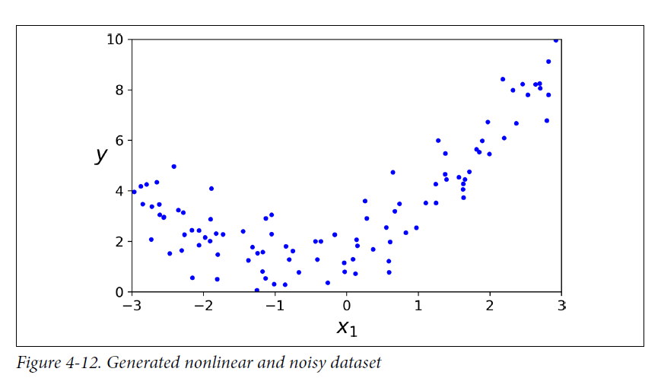
Polynomial Regression

Slide 54
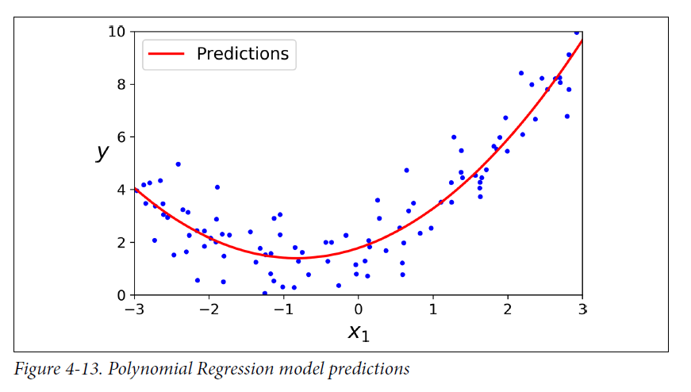
Polynomial Regression

Slide 55

Ridge Regression
Ridge Regression (also called Tikhonov regularization) is a regularized version of Linear Regression: a regularization term equal is added to the cost function.
This forces the learning algorithm to not only fit the data but also keep the model weights as small as possible.
Note that the regularization term should only be added to the cost function during training.
Once the model is trained, you want to use the unregularized performance measure to evaluate the model’s performance.

Slide 56
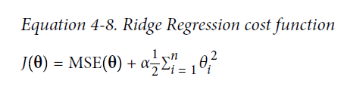
Ridge Regression
The hyperparameter α controls how much you want to regularize the model.
If α = 0, then Ridge Regression is just Linear Regression.
If α is very large, then all weights end up very close to zero and the result is a flat line going through the data’s mean.

Slide 57
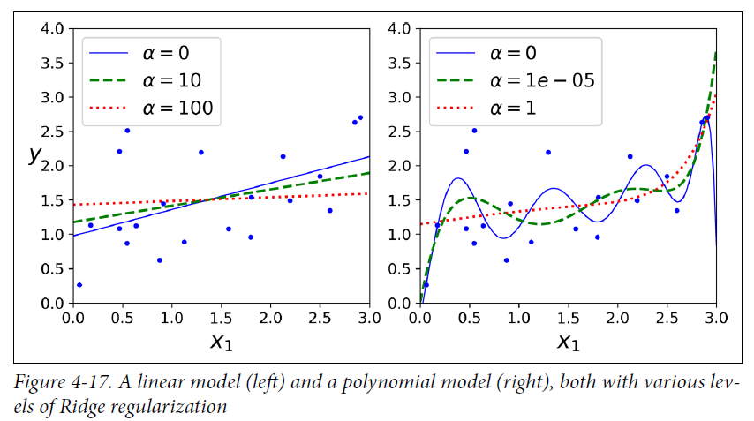
Ridge Regression

Slide 58

Lasso Regression
Least Absolute Shrinkage and Selection Operator Regression (usually simply called Lasso Regression) is another regularized version of Linear Regression.
Just like Ridge Regression, it adds a regularization term to the cost function, but it uses the ℓ1 norm of the weight vector instead of half the square of the ℓ2 norm.

Slide 59
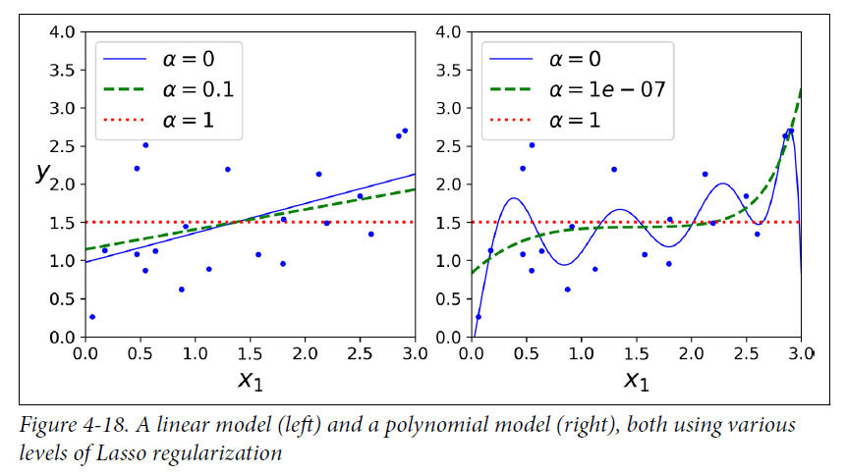
Lasso Regression

Slide 60
Elastic Net
Elastic Net is a middle ground between Ridge Regression and Lasso Regression.
The regularization term is a simple mix of both Ridge and Lasso’s regularization terms, and we can control the mix ratio r.
When r = 0, Elastic Net is equivalent to Ridge Regression, and
When r = 1, it is equivalent to Lasso Regression

Slide 61
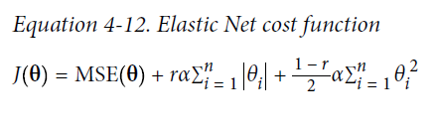
Elastic Net
So when should we use plain Linear Regression (i.e., without any regularization), Ridge, Lasso, or Elastic Net?
It is almost always preferable to have at least a little bit of regularization, so generally you should avoid plain Linear Regression.

Slide 62
Elastic Net
Ridge is a good default, but if we suspect that only a few features are useful, you should prefer Lasso or Elastic Net because they tend to reduce the useless features’ weights down to zero.
In general, Elastic Net is preferred over Lasso because Lasso may behave erratically when the number of features is greater than the number of training instances or when several features are strongly correlated.

Slide 63
Logistic Regression
Some regression algorithms can be used for classification.
Logistic Regression (also called Logit Regression) is commonly used to estimate the probability that an instance belongs to a particular class.
If the estimated probability is greater than 50%, then the model predicts that the instance belongs to that class (called the positive class, labeled “1”), and otherwise it predicts that it does not (i.e., it belongs to the negative class, labeled “0”).
This makes it a binary classifier.

Slide 64
Logistic Regression
Estimating Probabilities :
How does Logistic Regression work?
Just like a Linear Regression model, a Logistic Regression model computes a weighted sum of the input features (plus a bias term), but instead of outputting the result directly like the Linear Regression model does, it outputs the logistic of this result.

Slide 65
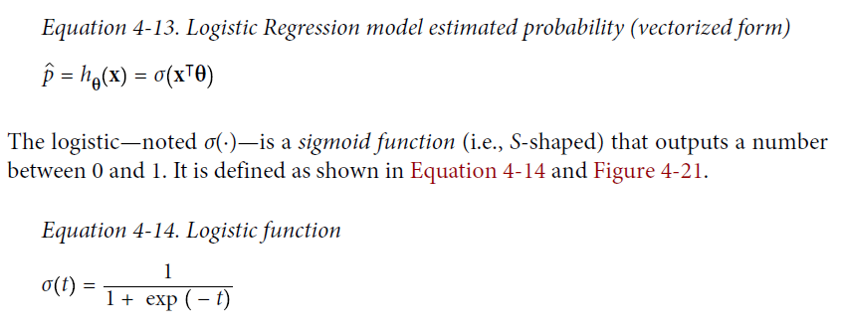
Logistic Regression

Slide 66
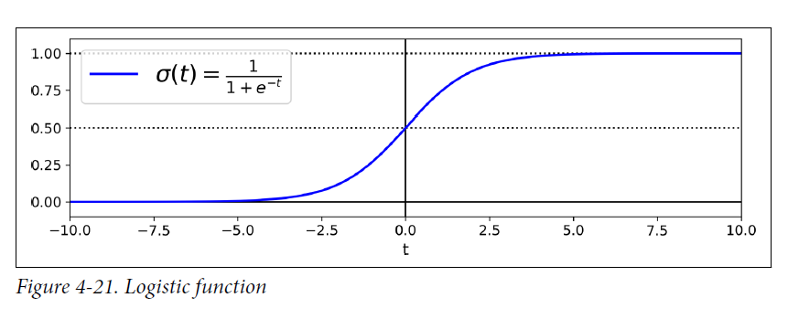
Logistic Regression

Slide 67
Softmax Regression
The Logistic Regression model can be generalized to support multiple classes directly, without having to train and combine multiple binary classifiers.
This is called Softmax Regression, or Multinomial Logist
The idea is simple: when given an instance x, the softmax Regression model first computes a score sk(x) for each class k, then estimates the probability of each class by applying the softmax function (also called the ormalized exponential) to the scores.
The equation to compute sk(x) should look familiar, as it is just like the equation for Linear Regression prediction.

Slide 68
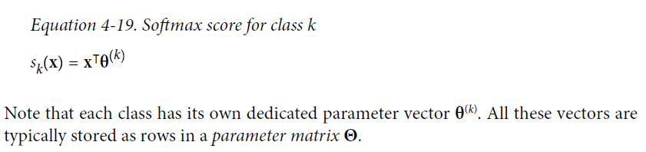
Softmax Regression
Once you have computed the score of every class for the instance x, you can estimate the probability p_{k} that the instance belongs to class k by running the scores through the softmax function

Slide 69
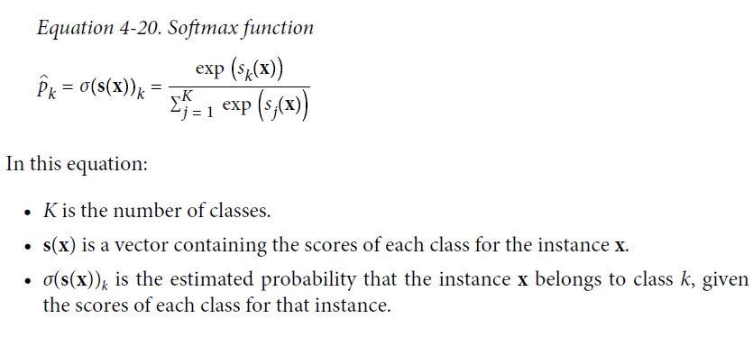
Softmax Regression

